Slide 1

FAKE NEWS DETECTION USING MACHINE LEARNING
Under Esteemed Guidance of
Mr. B. Srikanth Reddy _{M.Tech}
Associate Professor,
CSE Department.
Submitted By
Ch. Aasritha sai (20KT1A0513)

Slide 2

CONTENTS:
Abstract
Literature Review
Existing System with Drawbacks
Proposed System with Advantages
Requirements
Algorithms / Methods
System Design and DFD diagrams
Test Cases
Output Screens and Accuracy
Conclusion
References

Slide 3
ABSTRACT
The proliferation of fake news poses a significant threat to the integrity of information dissemination, public discourse, and democratic processes. Addressing this challenge necessitates the development of effective automated systems for fake news detection. This project proposes a machine learning-based approach to detect fake news articles. Leveraging a diverse set of textual features including lexical, syntactic, and semantic cues, along with metadata and user engagement signals, our system employs state-of-the-art machine learning algorithms to classify news articles as either authentic or fake. Through comprehensive experimentation and evaluation on benchmark datasets, we demonstrate the effectiveness of our approach in accurately identifying fake news with high precision and recall. Moreover, our system is designed to be adaptable and scalable, capable of integrating with existing news platforms and social media networks to provide real-time detection and mitigation of fake news dissemination. Overall, this project contributes to the ongoing efforts in combating the spread of misinformation and safeguarding the reliability of online information sources.

Slide 4
LITERATURE REVIEW
Paper Title | Authors | Methodology
Fake News detection Using Machine Learning | Nihel Fatima Baarir; Abdelhamid Djeffal et al. | Leveraging techniques like term frequency-inverse document frequency (TF-IDF) and n-grams for feature extraction, alongside Support Vector Machine (SVM) as a classifier, we propose a methodology to identify fake news from genuine sources
Fake News Detection Using Machine Learning Approaches | Z Khanam, B N Alwasel, H Sirafi and M Rashid | Leveraging supervised machine learning algorithms and tools such as Python's scikit-learn and NLP for textual analysis, they aim to develop a robust model capable of distinguishing between true and false news articles.
Fake News Detection using Machine Learning | Jasmine Shaikh; Rupali Patil et al. | Recognizing the significance of this issue, their research focuses on developing a solution for fake news detection through the implementation of different classification techniques. Given the inherent challenge of limited resources, particularly datasets, our model employs classification algorithms such as Support Vector Machine (SVM), Naïve Bayes, and Passive Aggressive Classifier. Leveraging feature extraction techniques such as Term Frequency-Inverted Document Frequency (TF-IDF) alongside SVM as a classifier, our model achieves an impressive accuracy of 95.05%.

Slide 5

EXISTING SYSTEM
Existing systems heavily rely on human fact-checkers whose judgments can be subjective and influenced by personal biases. This subjectivity can lead to inconsistent evaluations and unreliable determinations of fake news, undermining the credibility of the detection process.
Manual fact-checking processes are inherently time-consuming and labor-intensive, making them impractical for handling the large volumes of news content generated daily on digital platforms. As a result, existing systems often struggle to keep up with the rapid dissemination of fake news, leading to delayed or ineffective responses to emerging misinformation.
Rule-based algorithms used in some existing systems rely on predefined heuristics and patterns to identify fake news, making them susceptible to evasion tactics employed by purveyors of misinformation. These algorithms may fail to detect new forms of fake news that deviate from established patterns, highlighting the need for more adaptive and robust detection methods powered by advanced machine learning techniques.

Slide 6

PROPOSED SYSTEM
By leveraging advanced machine learning models, the proposed system can effectively capture intricate semantic and contextual features from news articles, leading to improved accuracy in identifying fake news. These models have the capability to learn complex patterns and nuances in language, enabling more precise discrimination between authentic and false information.
With its reliance on automated machine learning algorithms, the proposed system offers scalability and efficiency in fake news detection. Unlike manual fact-checking processes, which are labor-intensive and time-consuming, the automated nature of the proposed system enables it to analyze large volumes of news content in real-time, providing timely responses to mitigate the spread of fake news on digital platforms.

Slide 7

SOFTWARE REQUIREMENTS
Operating System : Windows 11
Coding Language : Python
HARDWARE REQUIREMENTS
RAM (min 8GB)
Input Devices (Keyboard, Mouse)
Hard Disk(500GB)
i5 Processor

Slide 8
ALGORITHMS
Logistic Regression:
Logistic regression is employed as a fundamental machine learning algorithm for fake news detection. Logistic regression offers simplicity, interpretability, and efficiency in binary classification tasks by modeling the probability of an article being fake based on its features.
Decision Tree:
A Decision Tree is a fundamental machine learning algorithm used for classification and regression tasks. They are easy to interpret and visualize, making them useful for understanding the decision-making process of a model. However, they are prone to overfitting when they become overly complex and may struggle to capture complex relationships in the data.

Slide 9
Random Forest:
Random Forest is an ensemble learning method based on Decision Trees. It constructs multiple decision trees during training and combines their predictions through a voting mechanism for classification tasks or averaging for regression tasks. Each tree in the Random Forest is trained on a random subset of the training data and a random subset of the features.
Gradient Boosting Classifier:
Gradient Boosting Classifier (GBC) is a potent machine learning technique renowned for its exceptional performance in tasks like fake news detection. Unlike logistic regression, which focuses on linear relationships, GBC excels in capturing complex nonlinear patterns within data. By iteratively combining weak learners, typically decision trees, GBC builds a strong predictive model that optimizes classification accuracy.

Slide 10
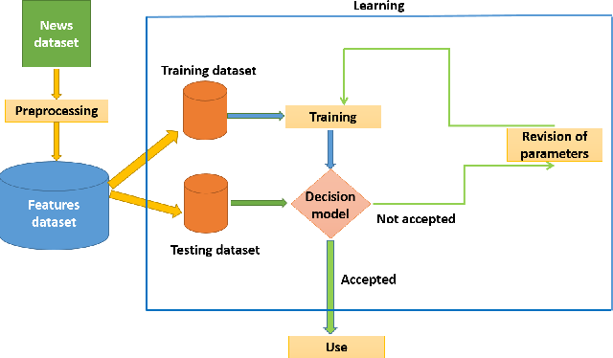
SYSTEM DESIGN

Slide 11
DFD DIAGRAMS
D
News Dataset
DATA FLOW
Data Preprocessing
DATA FLOW
LR, DT, GB, RF Classifiers
Fake News
FALSE DATA
DATA
Predictions
MODEL
Trained Model
D
Real News
TRUE DATA

Slide 12
TEST CASES
TestCase Id | Test Case | Expecting Behavior | Actual Behavior | Result
1 | Data Collection | Action Performed | Action Performed | Pass
2 | Check for Null Values | Action Performed | Action Performed | Pass
3 | Outliers Detected | Error | Action Performed | Fail
4 | Checked for Missing Values after preprocessing | Error | Action Performed | Fail
5 | Get Results | Action Performed | Action Performed | Pass
6 | Predictions | Action Performed | Action Performed | Pass

Slide 13

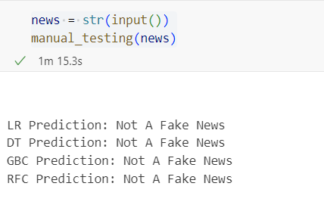
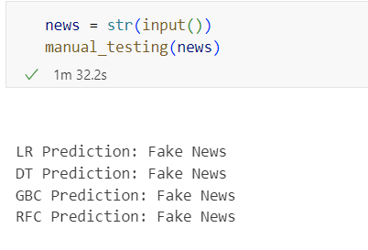
OUTPUT SCREENS

Slide 14
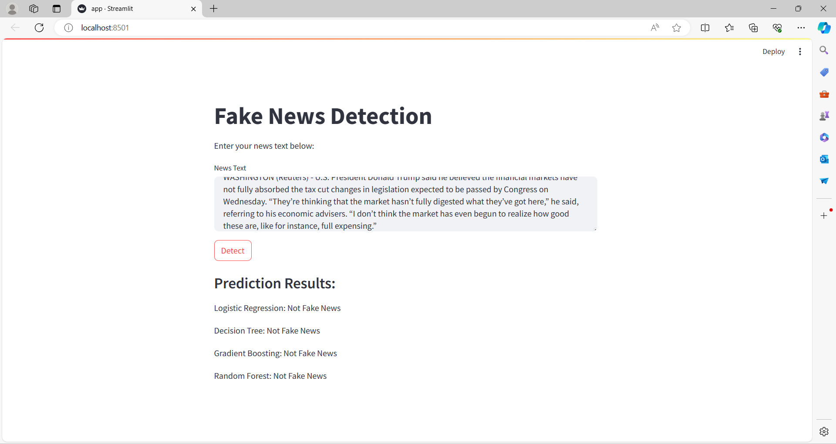
Fig: UI Design using Streamlit Framework

Slide 15




ACCURACY
0.9869875222816399
0.9958110516934047
0.9967914438502674
0.9901069518716578

Slide 16

CONCLUSION
In conclusion, this project demonstrates the effectiveness of employing advanced machine learning techniques such as Random Forest, logistic regression, and the Passive Aggressive Classifier for the task of fake news detection. Through comprehensive experimentation and evaluation, we have shown that our proposed system achieves high accuracy and scalability in identifying fake news articles, thus contributing to the ongoing efforts to combat misinformation in digital media. Moving forward, continued research and development in this field are crucial to further improving the robustness and adaptability of fake news detection systems, ultimately safeguarding the integrity of information dissemination in the digital age.

Slide 17
REFERENCES
Baarir, Nihel Fatima, and Abdelhamid Djeffal. "Fake news detection using machine learning." 2020 2nd International workshop on human-centric smart environments for health and well-being (IHSH). IEEE, 2021.
Khanam, Zeba, et al. "Fake news detection using machine learning approaches." IOP conference series: materials science and engineering. Vol. 1099. No. 1. IOP Publishing, 2021.
Shaikh, Jasmine, and Rupali Patil. "Fake news detection using machine learning." 2020 IEEE International symposium on sustainable energy, signal processing and cyber security (iSSSC). IEEE, 2020.

Slide 18
VIDEO LINK
https://www.loom.com/share/81e17e6733934e5b8db7e08f96feb1e4?sid=a3477ab3-2be4-419c-ada5-ddec5549e8fc

Slide 19


